Slide 1
Topic modelling example
A well-known dataset, “20 Newsgroups”
Documents from 20 newsgroups; 11,314 documents in the version I used (training set)
Newsgroups:
['rec.autos' 'comp.sys.mac.hardware' 'rec.motorcycles' 'misc.forsale'
'comp.os.ms-windows.misc' 'alt.atheism' 'comp.graphics'
'rec.sport.baseball' 'rec.sport.hockey' 'sci.electronics' 'sci.space'
'talk.politics.misc' 'sci.med' 'talk.politics.mideast'
'soc.religion.christian' 'comp.windows.x' 'comp.sys.ibm.pc.hardware'
'talk.politics.guns' 'talk.religion.misc' 'sci.crypt']
Notes:
Definition
Overview
More in-depth view
Tutorial

Slide 2
Processing
We first read and preprocess all documents
Preprocessing:
removing some characters and strings with regular expressions
tokenization (split document into words)
stopword elimination (“a”, “and”…)
minimum length enforcement (we set it to 3)
lemmatization (“went” -> “go”)
stemming (“sensational” -> “sensat”)
Collect the vocabulary from all documents
59,575 unique tokens; we keep only the 10,000 most frequent

Slide 3
Processing
Build two popular representations for each document:
plain term frequencies (“bag of words”, BoW)
tf-idf
Build two topic models (20 topics) with LDA, one for BoW and one for tf-idf
Visualize the topic model (BoW only for convenience) with pyLDAvis

Slide 4
An example of document
From: lerxst@wam.umd.edu (where's my thing)
Subject: WHAT car is this!?
Nntp-Posting-Host: rac3.wam.umd.edu
Organization: University of Maryland, College Park
Lines: 15
I was wondering if anyone out there could enlighten me on this car I saw
the other day. It was a 2-door sports car, looked to be from the late 60s/
early 70s. It was called a Bricklin. The doors were really small. In addition,
the front bumper was separate from the rest of the body. This is
all I know. If anyone can tellme a model name, engine specs, years
of production, where this car is made, history, or whatever info you
have on this funky looking car, please e-mail.
Thanks,
- IL
---- brought to you by your neighborhood Lerxst ----

Slide 5
An example of document
After removing some characters (e.g., newlines) and strings with regular expressions:
From: (wheres my thing) Subject: WHAT car is this!? Nntp-Posting-Host: rac3.wam.umd.edu Organization: University of Maryland, College Park Lines: 15 I was wondering if anyone out there could enlighten me on this car I saw the other day. It was a 2-door sports car, looked to be from the late 60s/ early 70s. It was called a Bricklin. The doors were really small. In addition, the front bumper was separate from the rest of the body. This is all I know. If anyone can tellme a model name, engine specs, years of production, where this car is made, history, or whatever info you have on this funky looking car, please e-mail. Thanks, - IL ---- brought to you by your neighborhood Lerxst ----

Slide 6
An example of document
After the full preprocessing:
55 words left, 49 unique (word “car” occurs 5 times, word “door”, 2, and word "look", 2)
['where', 'thing', 'subject', 'car', 'nntp', 'post', 'host', 'rac', 'wam', 'umd', 'edu', 'organ', 'univers', 'maryland', 'colleg', 'park', 'line', 'wonder', 'enlighten', 'car', 'saw', 'day', 'door', 'sport', 'car', 'look', 'late', 'earli', 'call', 'bricklin', 'door', 'small', 'addit', 'bumper', 'separ', 'rest', 'bodi', 'know', 'tellm', 'model', 'engin', 'spec', 'year', 'product', 'car', 'histori', 'info', 'funki', 'look', 'car', 'mail', 'thank', 'bring', 'neighborhood', 'lerxst']

Slide 7
Vocabulary
The vocabulary contains the 10,000 most frequent words in the preprocessed documents
First few entries:
0 'addit'
'bodi'
'bring'
'bumper'
'call'
'car'
'college‘
'day',
'door'

Slide 8
An example of document
The BoW representation for this document:
unique words are represented as indexes in the vocabulary
42 of the 49 unique words of this document are present in the vocabulary
since, coincidentally, this is the first document in the dataset, its words were the first to be inserted in the vocabulary (NB: in alphabetical order). Therefore, their indexes happen to be the first, but it’s not important
[(0, 1), (1, 1), (2, 1), (3, 1), (4, 1), (5, 5), (6, 1), (7, 1), (8, 2), (9, 1), (10, 1), (11, 1), (12, 1), (13, 1), (14, 1), (15, 1), (16, 1), (17, 1), (18, 1), (19, 2), (20, 1), (21, 1), (22, 1), (23, 1), (24, 1), (25, 1), (26, 1), (27, 1), (28, 1), (29, 1), (30, 1), (31, 1), (32, 1), (33, 1), (34, 1), (35, 1), (36, 1), (37, 1), (38, 1), (39, 1), (40, 1), (41, 1)]

Slide 9
An example of document
The tf-idf representation for this document:
note the changes to the relative frequencies
[(0, 0.11508442817773791), (1, 0.11685057831170038), (2, 0.10456035163095019), (3, 0.19896571341777863), (4, 0.07963218255191856), (5, 0.48155481965801966), (6, 0.1055901817721483), (7, 0.07269467616139666), (8, 0.2710264439439116), (9, 0.1179554553082054), (10, 0.04863998565248088), (11, 0.0862932890573073), (12, 0.18340279049813846), (13, 0.2497846855427294), (14, 0.11457177783495281), (15, 0.02917346631574589), (16, 0.09768538767174806), (17, 0.03711699368049964), (18, 0.12419581401291628), (19, 0.11245948040574812), (20, 0.07165494230955832), (21, 0.1624752269645684), (22, 0.11291605604833643), (23, 0.19523966229762876), (24, 0.02969577526919512), (25, 0.1291317450322251), (26, 0.10349888872509058), (27, 0.2457291354618299), (28, 0.1111822519746563), (29, 0.11685057831170038), (30, 0.12651536951197986), (31, 0.10078068649118861), (32, 0.14750624995128475), (33, 0.13428883062011865), (34, 0.058700053499970276), (35, 0.05831719013606671), (36, 0.19268794854030857), (37, 0.030928779903281762), (38, 0.23306749659783652), (39, 0.21655465471348062), (40, 0.09552164848273034), (41, 0.0586164594345401)]

Slide 10
An example of document
The topics for this document (with both BoW and tf-idf):
Topics for this document (LDA BoW):
[(10, 0.35617992), (13, 0.6254527)]
Score: 0.6255542039871216 Topic: 0.014*"car" + 0.008*"articl" + 0.007*"like" + 0.006*"work" + 0.006*"space"
Score: 0.3560783863067627 Topic: 0.011*"space" + 0.010*"wire" + 0.005*"nasa" + 0.005*"center" + 0.005*"research"
Topics for this document (LDA tf-idf):
[(1, 0.03618599), (3, 0.48642957), (15, 0.33754307), (18, 0.123514846)]
Score: 0.48652100563049316 Topic: 0.005*"bike" + 0.003*"car" + 0.003*"orbit" + 0.002*"ride" + 0.002*"engin"
Score: 0.3374459445476532 Topic: 0.003*"key" + 0.003*"chip" + 0.003*"encrypt" + 0.002*"think" + 0.002*"clipper"
Score: 0.12352421134710312 Topic: 0.005*"atari" + 0.004*"triniti" + 0.004*"nintendo" + 0.004*"roth" + 0.004*"nsa"
Score: 0.03618228808045387 Topic: 0.010*"printer" + 0.006*"postscript" + 0.005*"european" + 0.005*"print" + 0.004*"winbench"

Slide 11
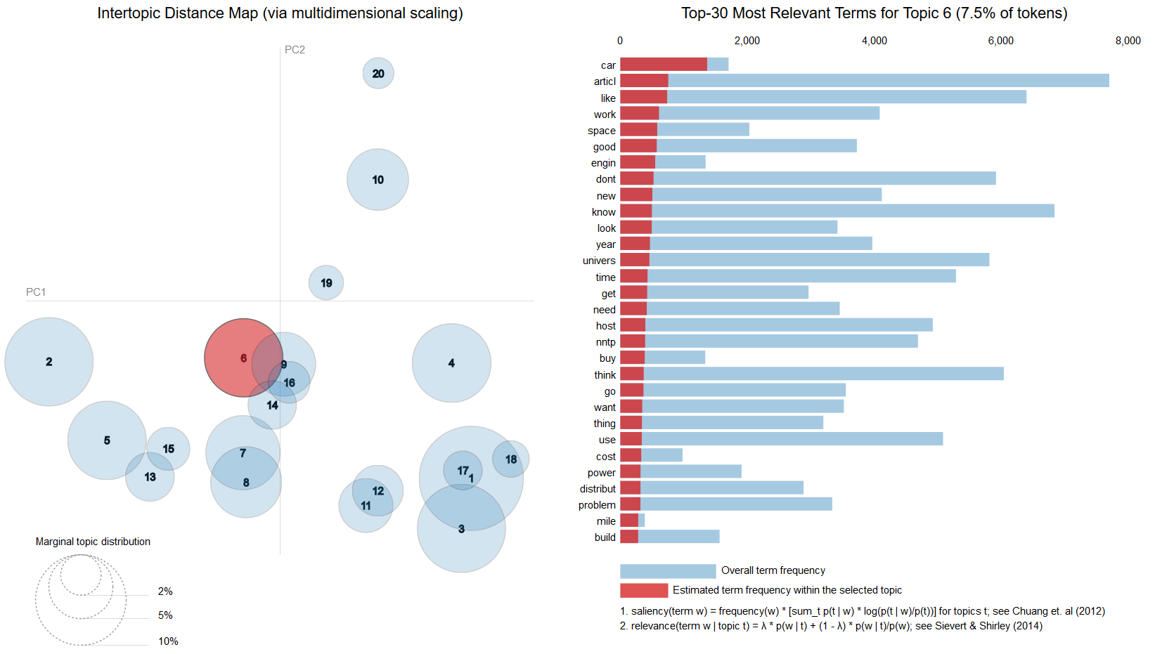
A view of the topics
NB: here the topics are numbered in decreasing size order. The topic of index 13 in LDA BoW is number 6

Slide 12
Comments
In this case study, the number of topics can be chosen with some external information (that is, the number of newsgroups)
In general, various quantitative heuristics can be applied + expert opinion
Other parameters influence the effectiveness of the outcome (preprocessing steps, size of vocabulary etc)
Try until you’re satisfied!

